Slide 1
Lydia Egbo & Patrick Bannon
Aston University, 17th September 2025
NEXUS: Next-Gen Technologies for Enhanced Metro Operations

Slide 2

Key Facts
“Next-gen technologies for enhanced metro operations”
13 Partners
2 Use Cases
3 Workstreams
10 Work Packages
24 Months
3 Flagship Projects
7 Countries

Slide 3
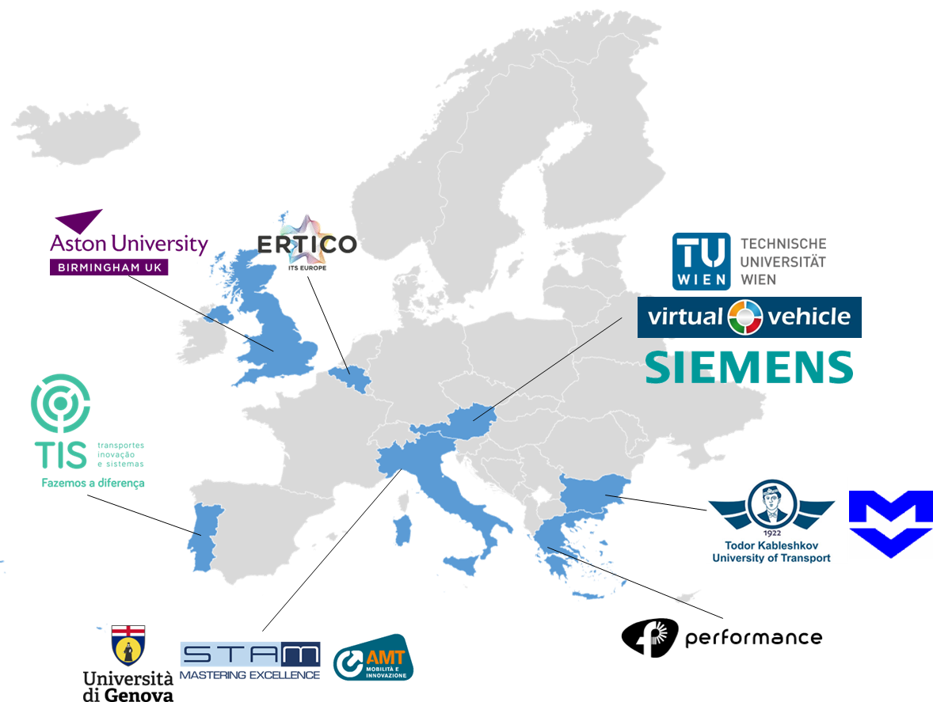

Consortium

Slide 4
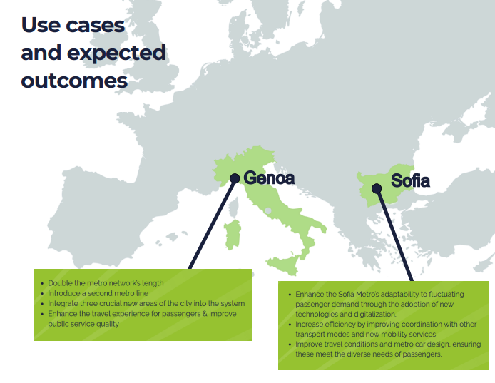
NEXUS – Use Cases

Slide 5











External Advisory Board
Members and Activities
Provision of expert opinion about ongoing project developments, feeding and enriching the project research
Consultation at NEXUS different steps
Support to project partners with ad hoc inputs on surveys/questionnaires, sharing them within their networks for enhancing project reach
Validation of NEXUS intermediate and final results
Participation in project workshops activities that may require their attention, providing expert support

Slide 6
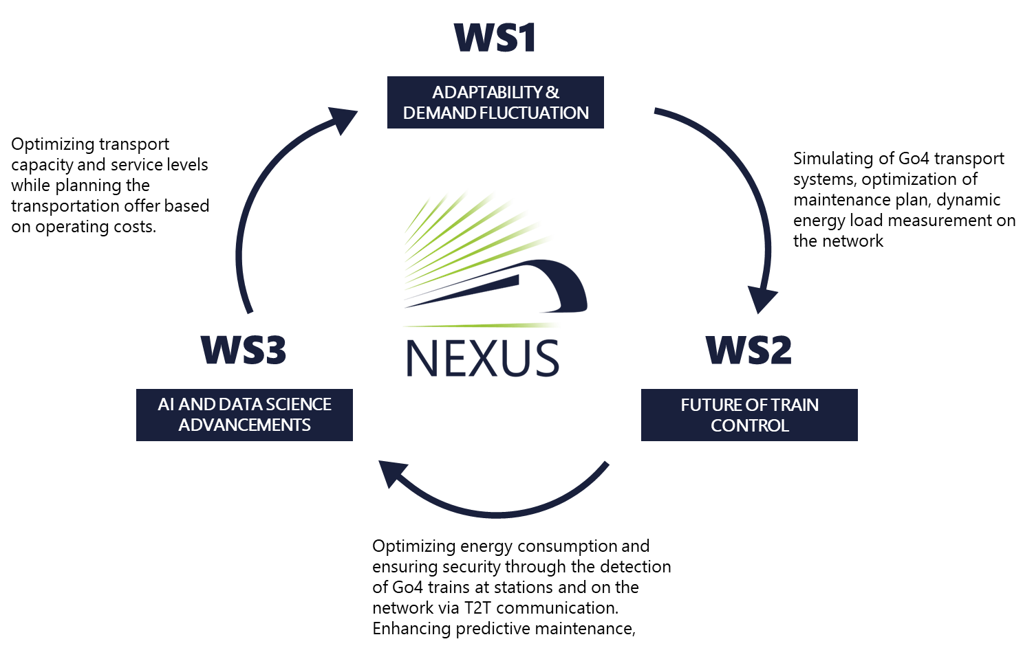
Mission
NEXUS
NEXUS aims to set an innovation benchmark in urban transport, addressing key challenges and guiding European metro systems toward transformative futures. The project operates through three interconnected workstreams:
WS1 focuses on enhancing metro adaptability to demand fluctuations, using simulations and user-centered optimization.
WS2 explores future train control systems, emphasizing automation, sustainability, and safety.
WS3 applies AI and data science to optimize metro operations.
Together, these workstreams aim to create more efficient, adaptable, and sustainable metro systems with strong stakeholder engagement.

Slide 7

Aston University - Achievements
Community of Practices
Advanced modelling approaches and data implementation campaign
Our Team:
Dr Marin Marinov
Dr Francis Tong
Lydia Egbo
Prachiti Shinde
Patrick Bannon
Analysis of Existing Control Systems
Integrated simulation modelling for metro networks
Data Science and AI in Future Metro Operations
Technical dissemination and events

Slide 8










NEXUS – Achievements
Community of Practices
Aston University led this task, seeking to engage in dialogue with various metro operators, bringing together various sectors and departments to collectively envisage the future of metro. Focusing on an operator’s internal procedures, organisational structures, future innovation, as well as three designated use cases. Insights were gathered through surveys, workshops and interviews with various operators and advisory board members. The completed paper was an aspect of a wider deliverable focusing on “Requirements, Framework and State-of-the-Art.”
Predictive Maintenance
Energy Consumption
Cyber-Security

Slide 9
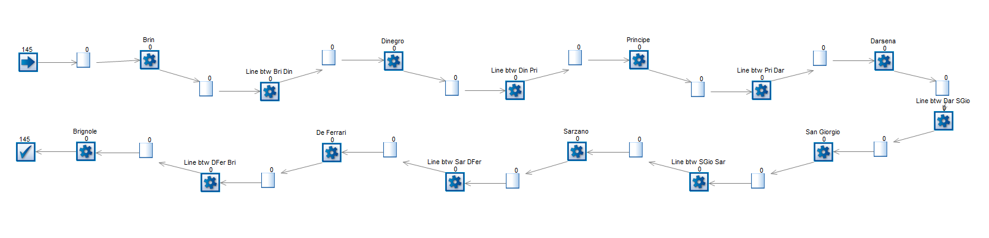
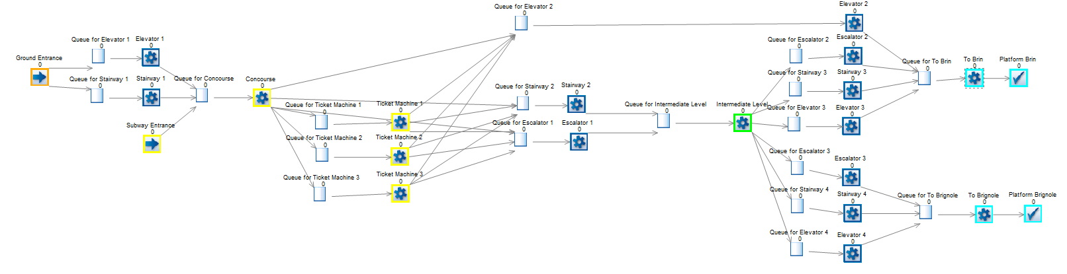
NEXUS – Achievements
Advanced modelling approaches and data implementation campaign
Aston led this task and the deliverable, completing the comprehensive State-of-the-Art literature review and compiled the outputs and contributions from all participating partners.
Aston has developed a total of six models:
Four Metro Network models were developed to simulate the train operations.
Two Metro Station models were developed to simulate passenger behaviour within the stations.
Network Models:
Sofia Metro (2)
Genoa Metro (2)
Station Models:
Serdika – Sofia Metro
De Ferrari – Genoa Metro

Slide 10

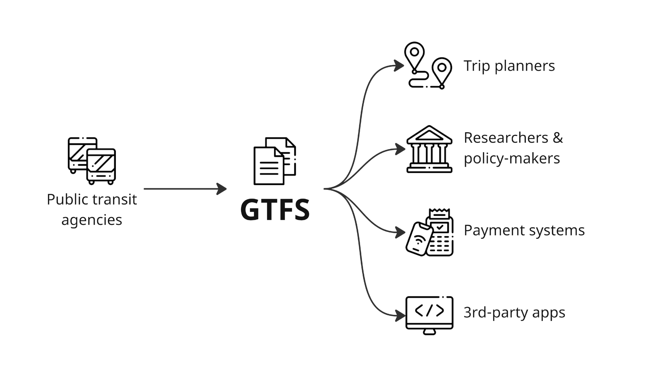
NEXUS – Achievements
Analysis of Existing Control Systems:
Aston University conducted a systematic literature review analysing existing train control systems such as CBTC and TCMS. As well as, supporting partners with the study of the current economical, operational, maintenance and technological impacts of the existing control systems. The study of the current economical, operational, maintenance and technological impacts of the existing control systems are also addressed within this deliverable.
Data Science and AI in Future Metro Operations:
Aston completed two comprehensive literature reviews, focusing on Timetable Creation using GTFS data and Demand Forecasting.
As part of the Literature Review looking at GTFS data, the review focused specifically on the utilisation of GTFS data, frequency of service and tactical planning. As well as the developing a log linear model for demand forecasting in metro systems and a conceptual AI use case on the creation of timetable using GTFS data

Slide 11

NEXUS – Next Steps
Next Steps
Validation, Exploitation and Improvement Campaign
Further technical dissemination and events
Techno-economic financial and sustainability analysis
TRA2026
Budapest

Slide 12
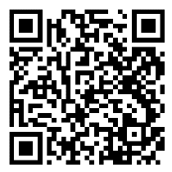
Thank You!
nexus-heproject.eu
Lydia Egbo – l.egbo@aston.ac.uk
Patrick Bannon – p.bannon@aston.ac.uk
NEXUS Project
nexus-heproject.eu

